Slide 1
COFFEE LEAF RUST SOLVING: WIRELESS SENSOR NETWORK, DATA STRUCTURES AND ALGORITHMS
Miguel Angel Correa Manrique
Pablo Buitrago Jaramillo

Slide 2
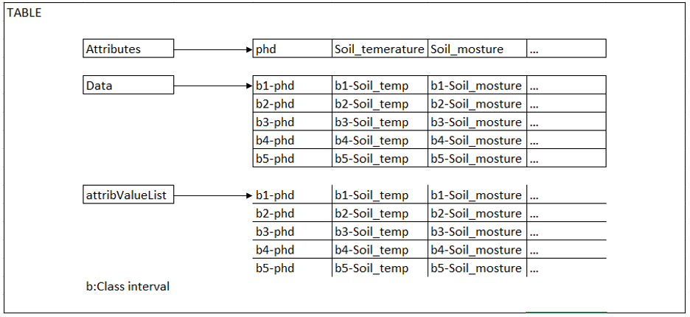
Designed data structure: Table
Figure 1: On the abstraction every data attribute represents a column and every data in the structure is allocated in a vector of vectors that represents the rows of the matrix

Slide 3
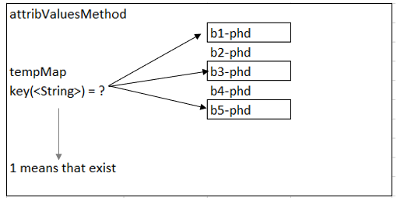
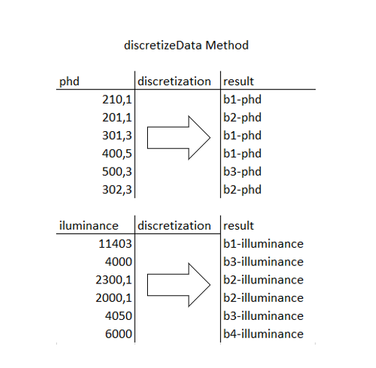
Data Structure Operations
Figure 3 : Demonstrates how the data is discretized graphically.
Figure 2: the attribValue Method contains only existent class intervals. It gives the categories on each column of the data set (already discretized).

Slide 4
Quartiles

Slide 5
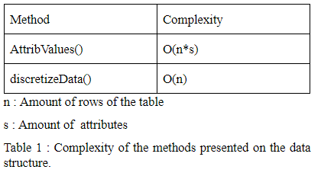
Complexity Table

Slide 6

Design Criteria of the Data Structure
The data values are stored in ArrayList to access the data in constant time and because its insert and delete qualities.
The time complexity to access on ArrayList is O(1)
ArrayList is suited to the way we want to address the problem
On the abstraction the columns are represented by “Attributes” and the data categorization is represented by “Attribute List”

Slide 7
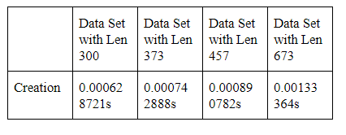
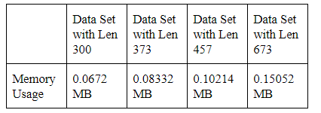
Time and Memory Consumption
Table 3 : Memory used for each operation of the data structure and for each data set data sets.
Note that the memory usage is an approximation given by the amount of data received multiplicated by the bytes of the string data type in C++ language times the number of rows presented on the data set.
Table 2 : Execution time of the operations of the data structure for each data set

Slide 8
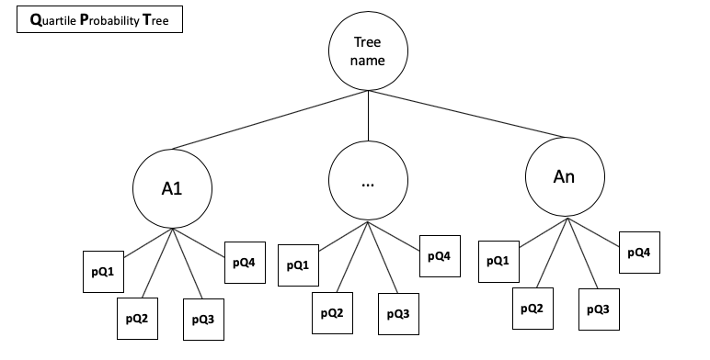
Designed Data Structure: BQPT
Figure 4: Abstraction of a Quartile probability tree. Each node represents a data attribute, all of them has 4 leaves; a leaf lodges a probability for the data in the class that the leaf represents

Slide 9
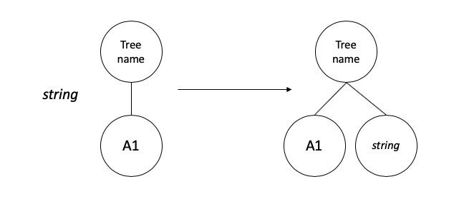
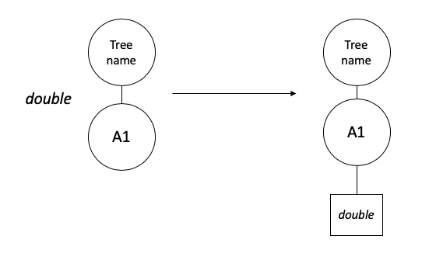
Data structure operations
newNode(string)
newNode(double)

Slide 10
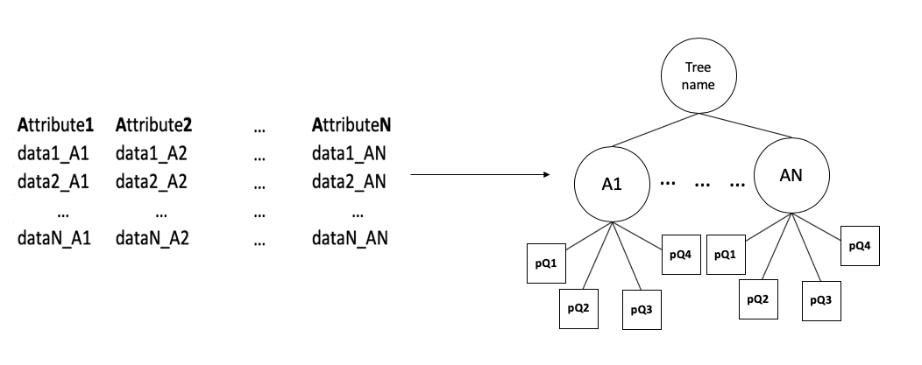
make(DataFrame)

Slide 11
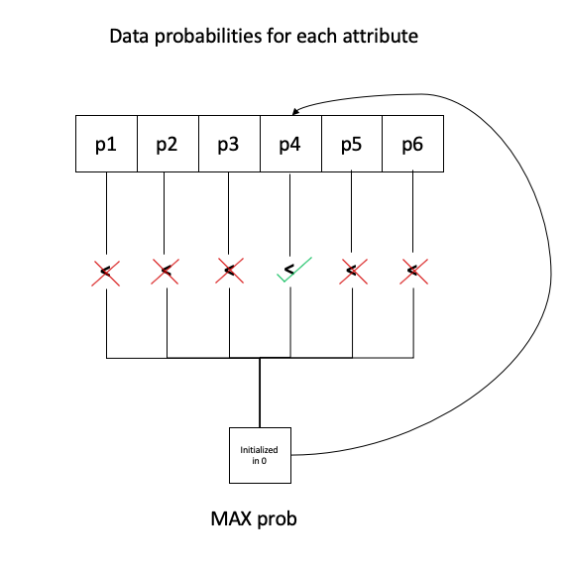
decision(string)

Slide 12
Complexity Table

Slide 13
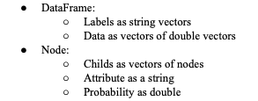
Design Criteria of the Data Structure
We need a structure that works as a tree
Works for every dataset that can be a matrix n*s
The distribution of the data in the class intervals using quartiles

Slide 14
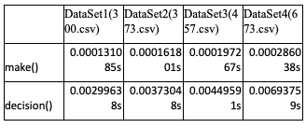
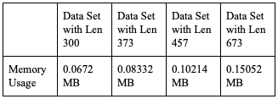
Time and Memory Consumption
Table 5: Memory used for each operation of the data structure and for each dataset
Table 4 : Execution time of the operations of the data structure BQPT for each data set

Slide 15
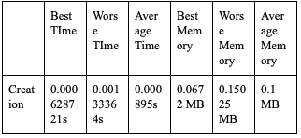
Result Analysis

